Slide 1
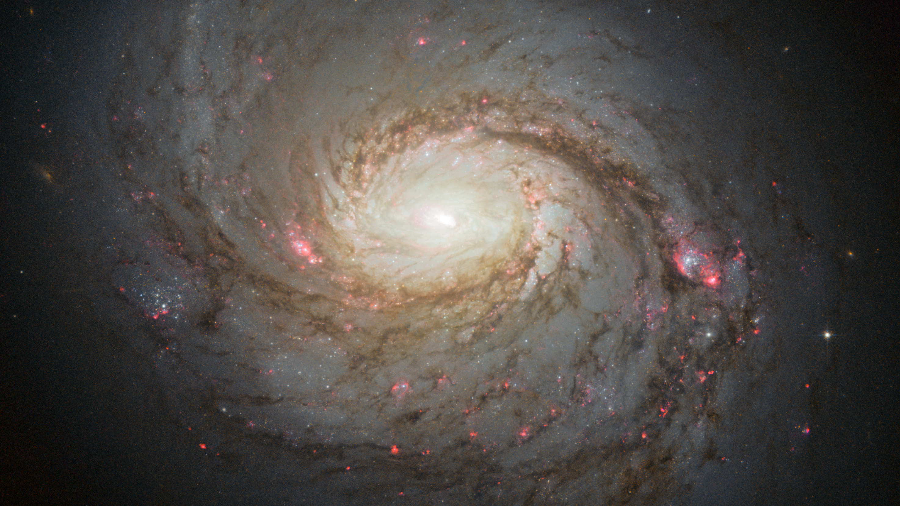
Conducting a Variability Study of Active Galactic Nuclei Using Long-Short Term Memory Networks

Slide 2
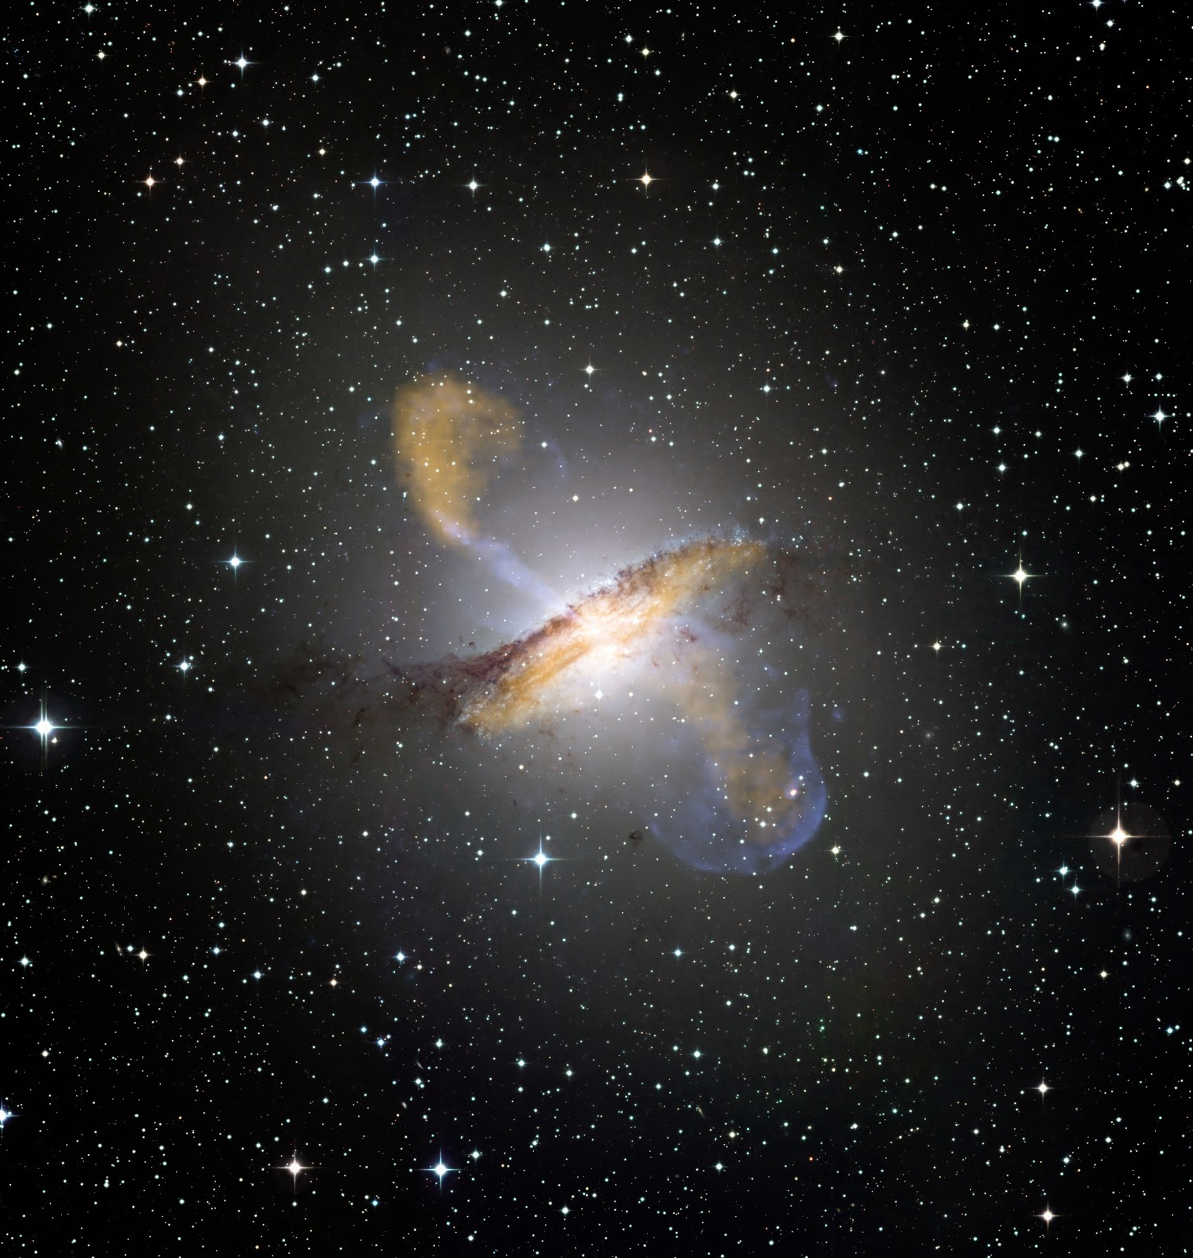
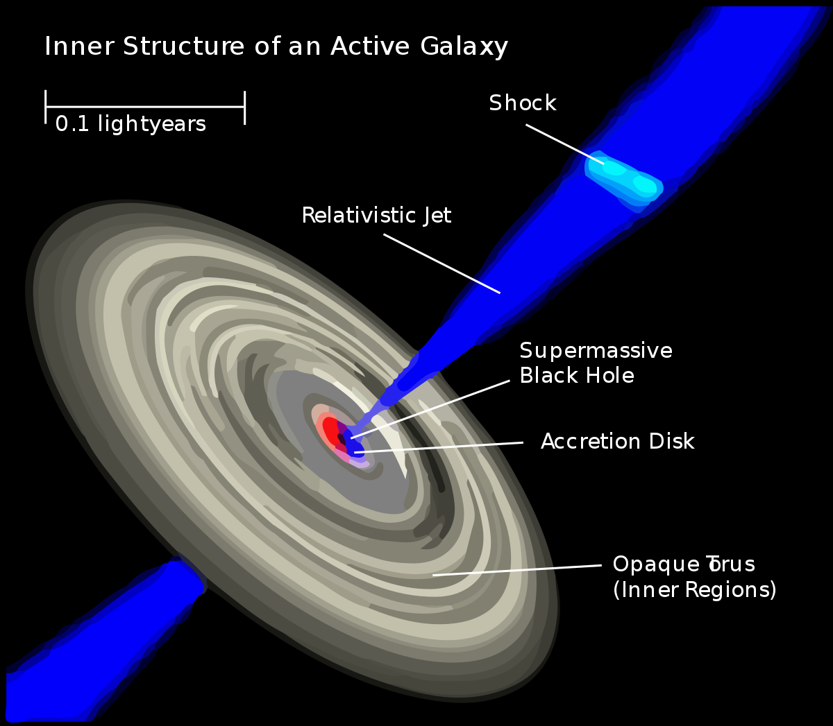

Slide 3
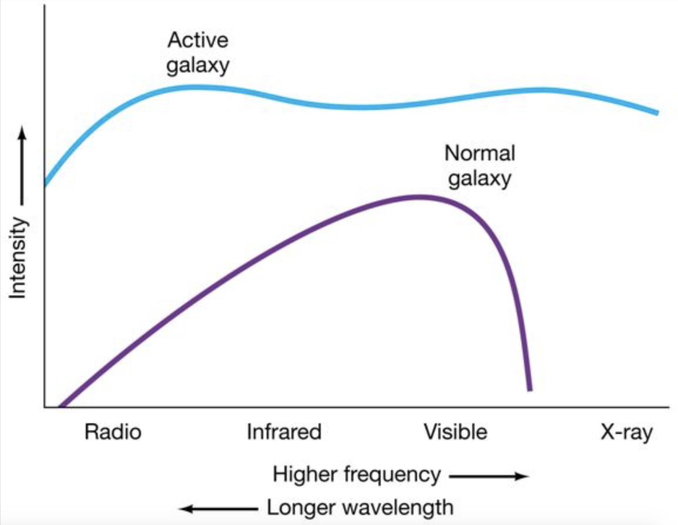

Slide 4
Create data
Create light curves for a large group of active galactic nuclei
Model data
Model light curves using LSTM RNNs
Analyze
Analyze model/data to come to conclusions

Slide 5
Part 1: Data Creation

Slide 6
Create list of AGNs by narrowing down catalogue from ~2,000,000 to ~2,000
Cut out a postcard from the full frame, generate aperture, and generate raw light curves for inside and outside aperture
Use background subtraction, PCA, and normalization to correct for background contamination, common systematics, and telescope pointing errors
Download .fits full frame images from Mikulski Archive for Space Telescopes using TESScut

Slide 8
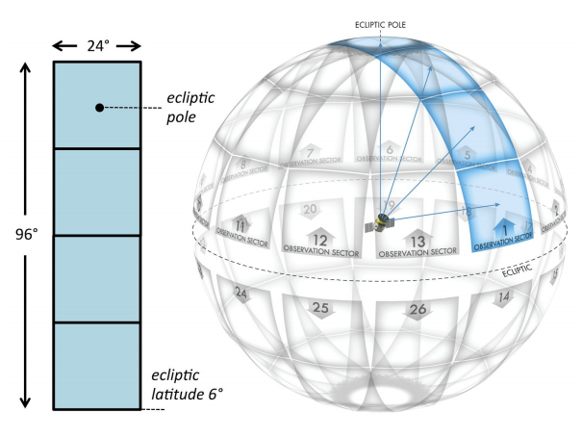

Slide 10
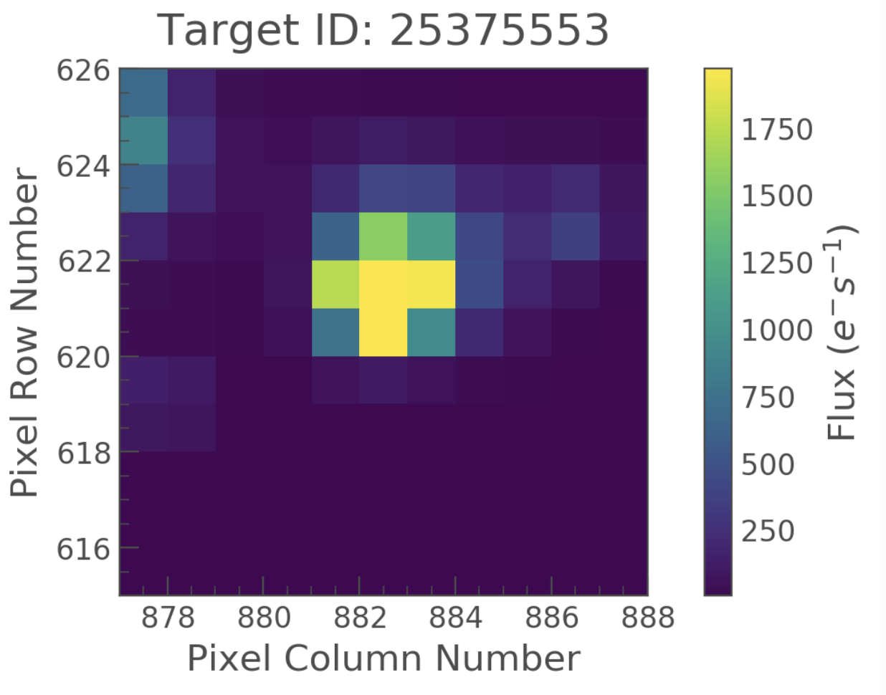

Slide 11
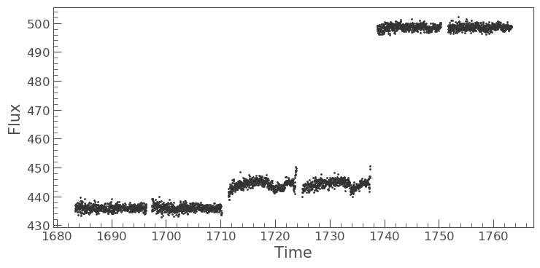

Slide 12
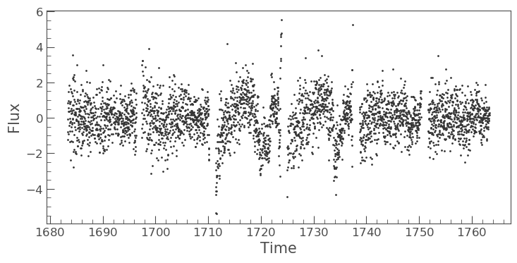

Slide 13
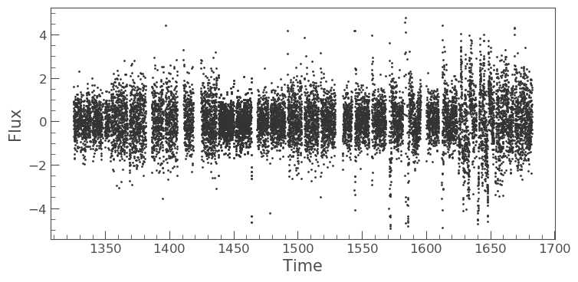

Slide 14
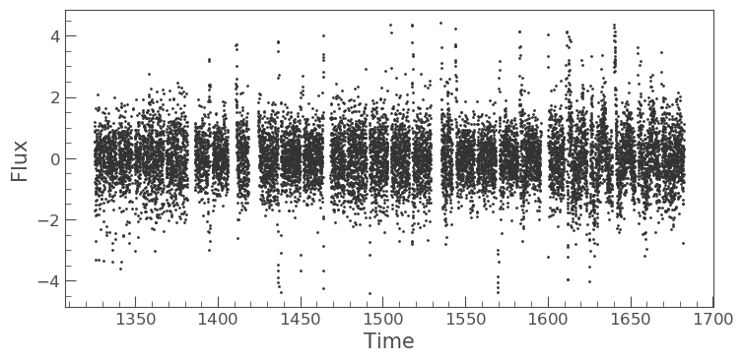

Slide 15
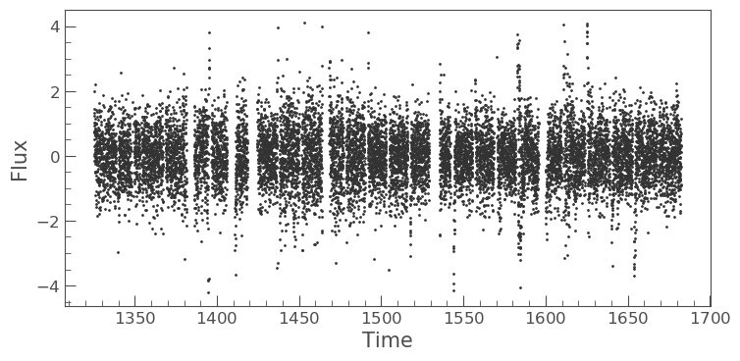

Slide 16
Part 2: Data Modelling

Slide 17
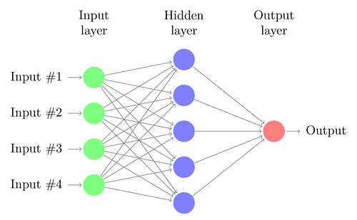

Slide 18
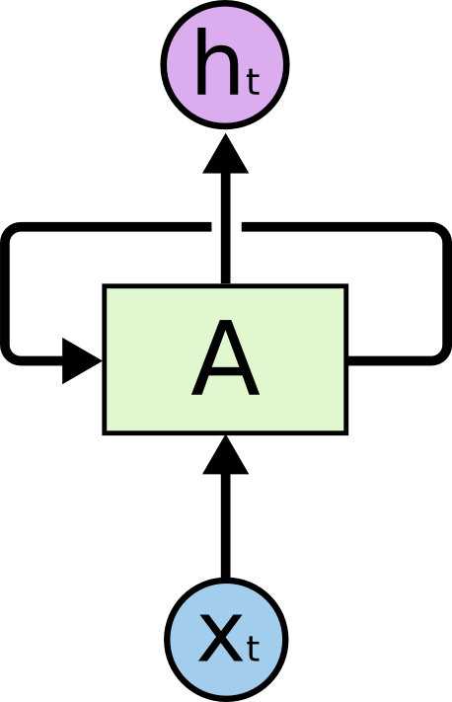

Slide 20
Jupiter is a little to the whole of the solar surface, the components of a spot strong below the sun and the sun is the same size of the bright orbits and other at the comet. The sun is at the centre of the moon, as shown in Fig. 307. [Illustration: Fig. 353.] The _least the telescope is about twenty-four hours, and the position of the compound of the sun is about twelve months of the edge of the earth, and all the water of the planet are shown in Fig. 249. The majority of the comet of the earth is at _a_ to _M_ the bright orbits of the sun and _Pleiad_, the radius of the moon is all supposed to be above the other planets. Fig. 126 shows the sun is about the large disk and the planet are considerably seasons, and are confined as a reason from the sun and the spot. When the moon is only about a hundred and fifty thousand years of the compound of the average constellations in the atmosphere, and the same motion of the moon is greater than the surface of the sun. [Illustration: Fig. 221.] The revoluti . . .

Slide 21
Jupiter is a little to the whole of the solar surface, the components of a spot strong below the sun and the sun is the same size of the bright orbits and other at the comet. The sun is at the centre of the moon, as shown in Fig. 307. [Illustration: Fig. 353.] The _least the telescope is about twenty-four hours, and the position of the compound of the sun is about twelve months of the edge of the earth, and all the water of the planet are shown in Fig. 249. The majority of the comet of the earth is at _a_ to _M_ the bright orbits of the sun and _Pleiad_, the radius of the moon is all supposed to be above the other planets. Fig. 126 shows the sun is about the large disk and the planet are considerably seasons, and are confined as a reason from the sun and the spot. When the moon is only about a hundred and fifty thousand years of the compound of the average constellations in the atmosphere, and the same motion of the moon is greater than the surface of the sun. [Illustration: Fig. 221.] The revoluti . . .

Slide 22
Part 3: Data Analysis

Slide 23
